Slide 1
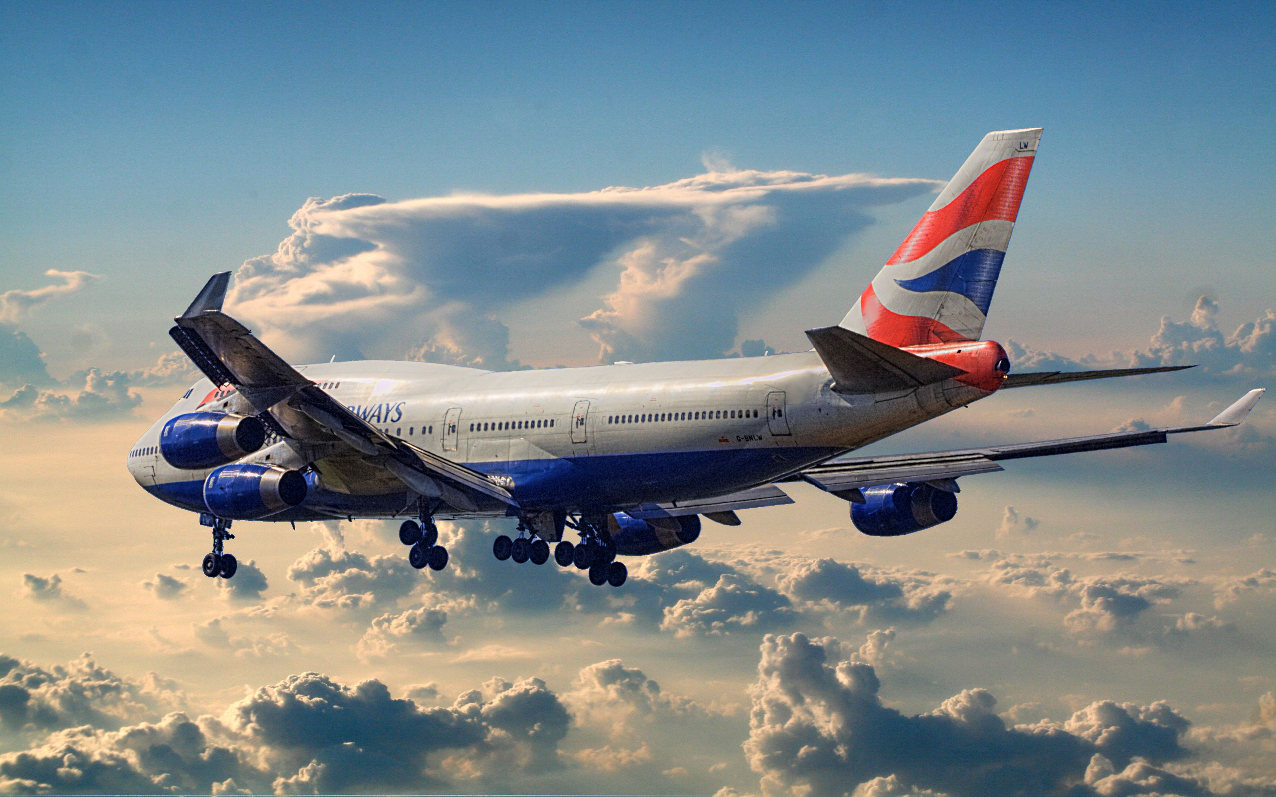
British Airways Reviews
Customer Feedback & Analysis
Power By:- Bhawna Saini
email - bhawanasaini350@gmail.com

Slide 2
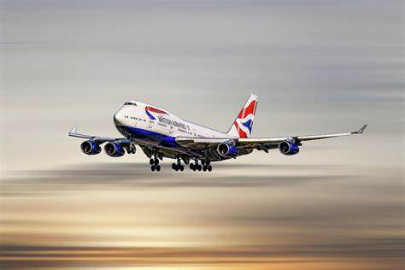
Table of contents
Introduction
Seat comfort by seat type
Analysis
Insights
Value for money by seat type
Analysis
General Insights
Cabin staff service by seat type
Analysis
General Insights
Food and bevarges by seat type graph
Review Analysis
General Insights
Recoomendation rating by seat type graph
Analysis
Area of improvement
Avg rating by type of traveller
Analysis
Recoomendation
Avg rating by seat type
Analysis
Consideration for airlines
Analysis review
Review summary
Pros And Coins
Customer feedback
Conclusin
Thank you

Slide 3
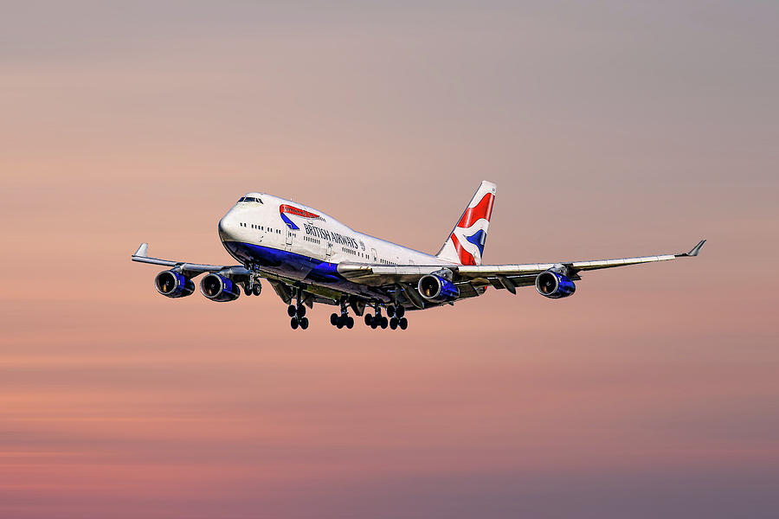
Introduction
An overview of British Airways' customer reviews, ratings, and overall service analysis.

Slide 4
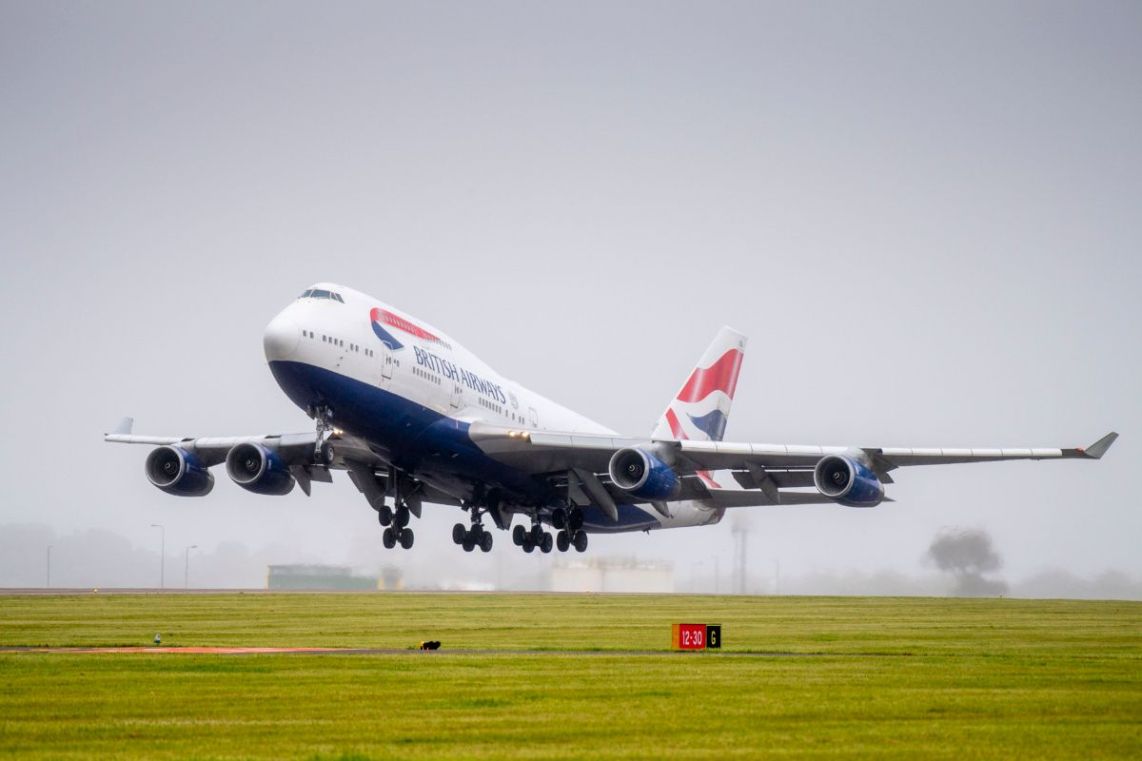
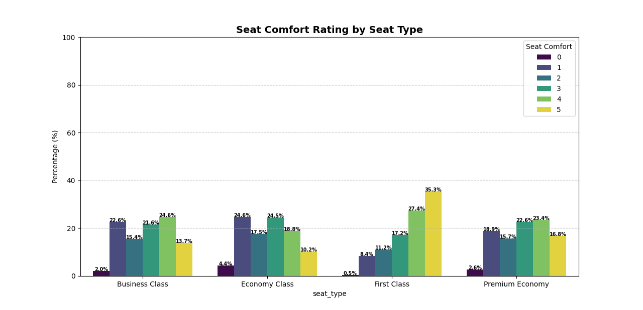
Seat Comfort By Seat Type

Slide 5
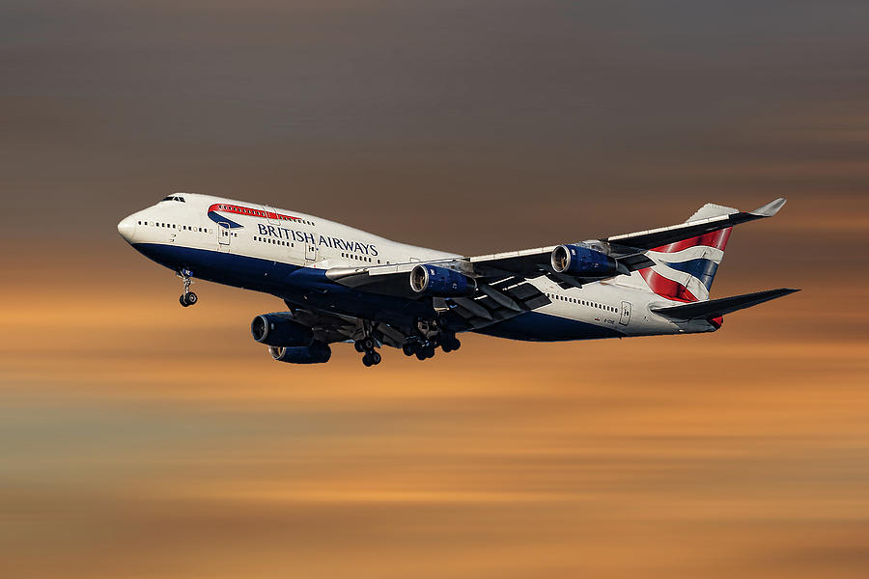
Analysis
Avg rating by seat comfort in Business Class- 2.9/5
Avg rating by seat comfort in Economy Class - 2.7/5
Avg rating by seat comfort in First Class - 3.7/5
Avg rating by seat comfort in Premium Class - 3.0/5

Slide 6
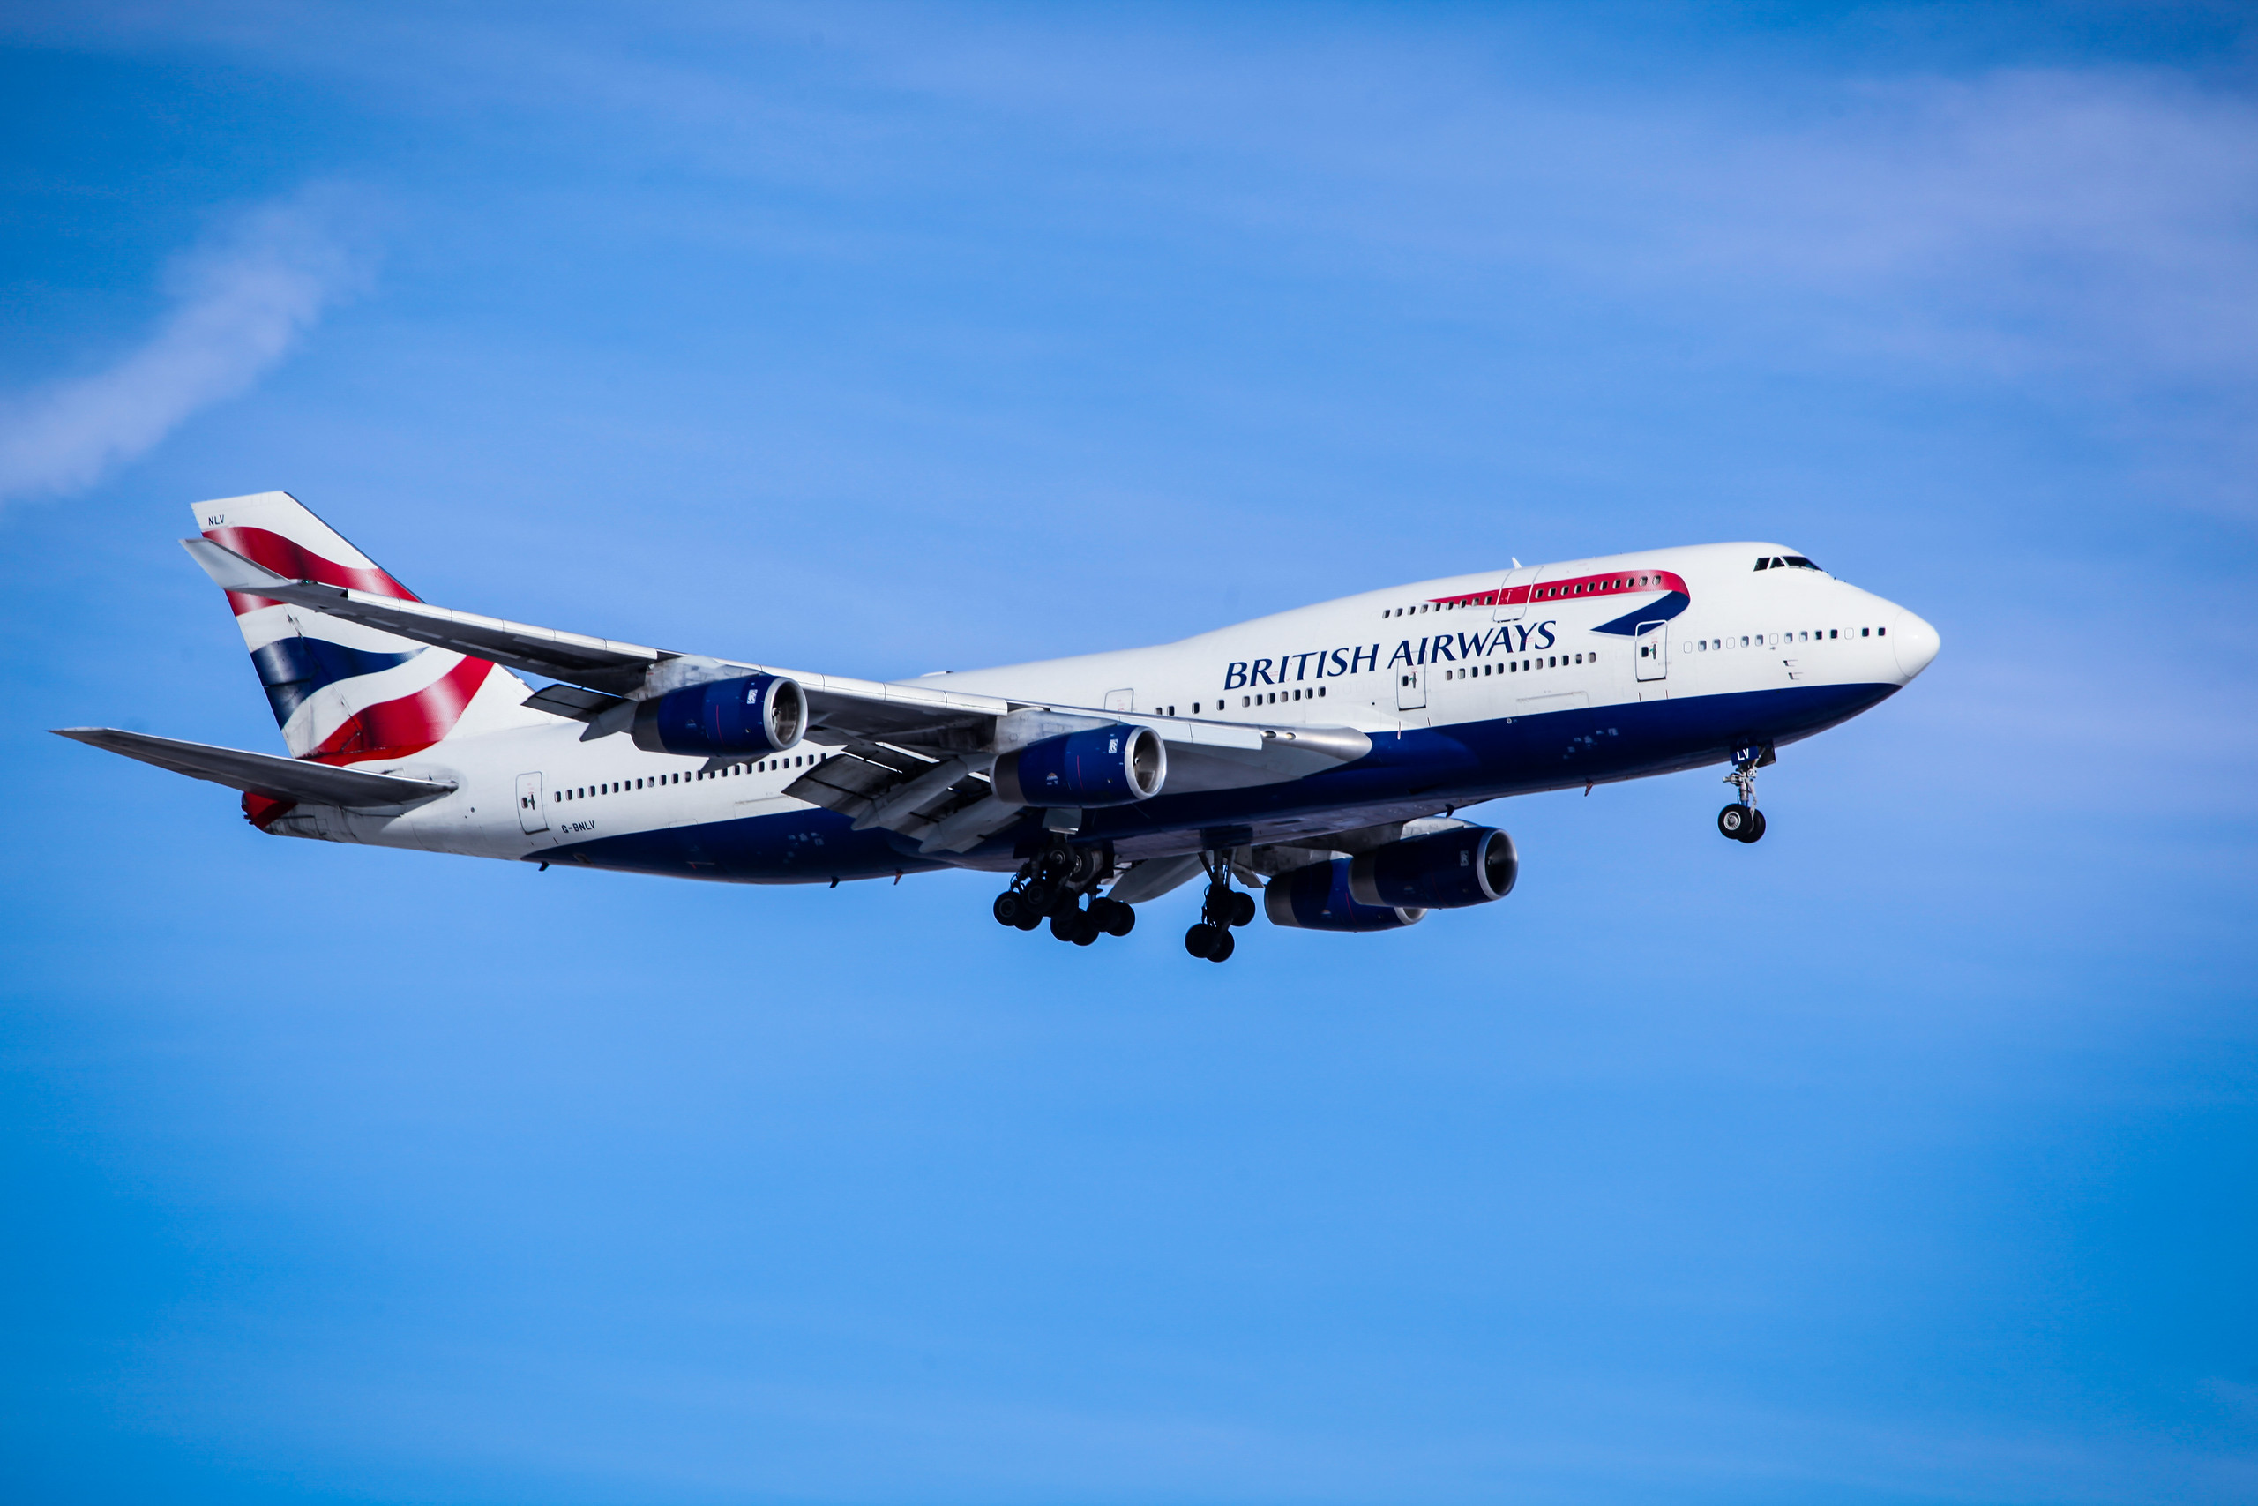
Insights & Recommendations:
Economy Class needs improvement: The high percentage of 1-star and 2-star ratings suggests that Economy Class passengers find seat comfort lacking. Improving legroom, seat padding, or reclining features may help.
First Class is well-received: The highest proportion of 5-star ratings suggests that First Class seating meets passenger expectations.
Premium Economy and Business Class show mixed responses: While they have decent comfort ratings, they still have some low ratings (0 and 1 stars) that need attention.

Slide 7
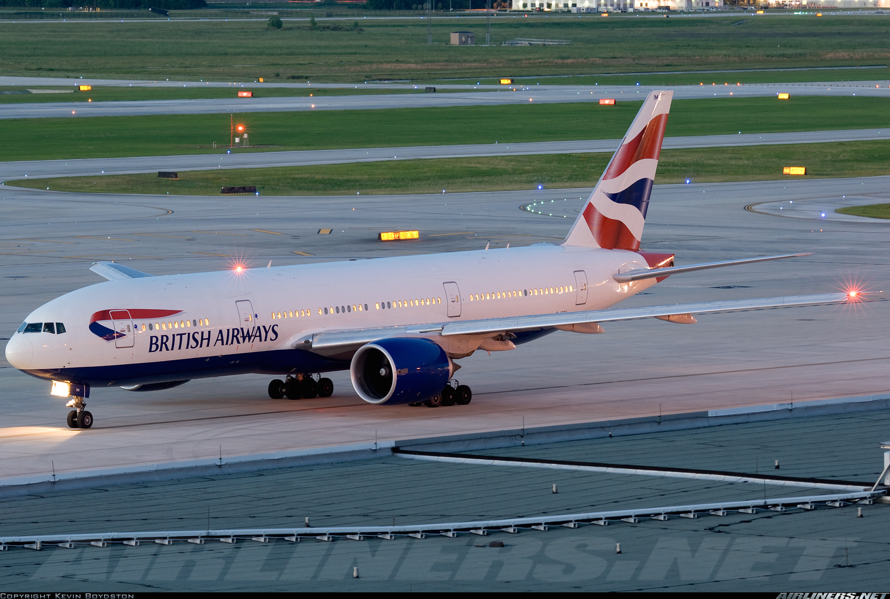
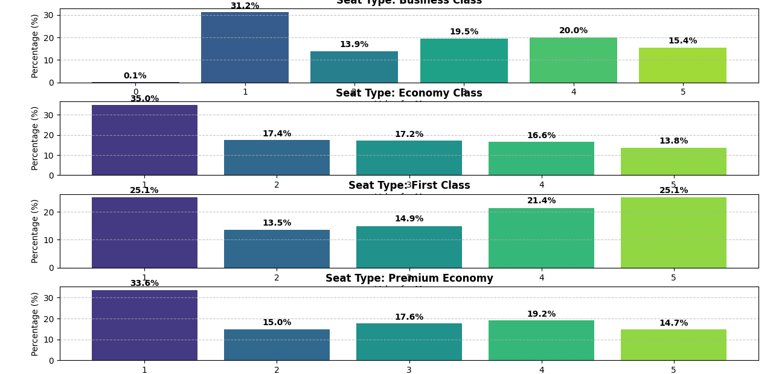
Value For Money By Seat Type

Slide 8
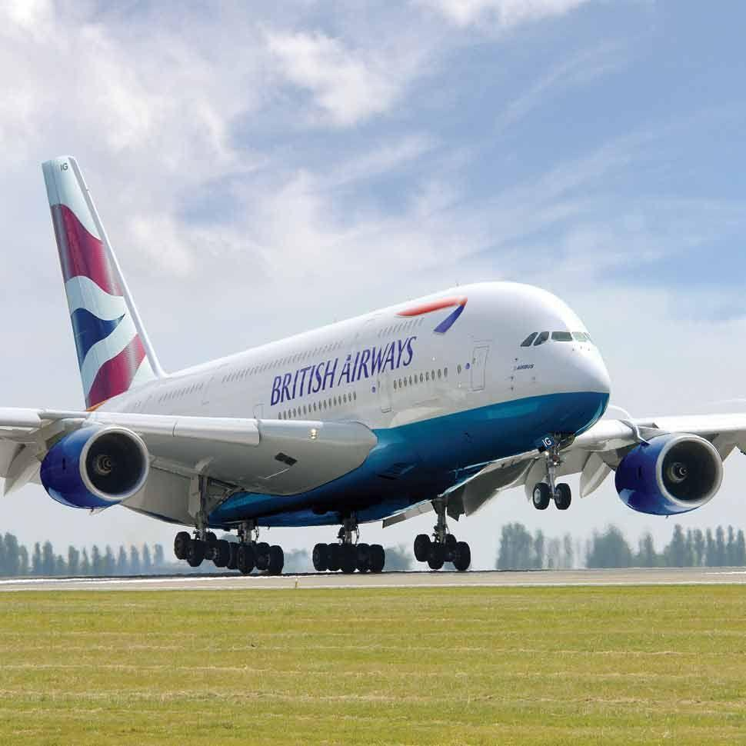
Analysis
Avg rating by value for money in Business Class - 2.7/5
Avg rating by value for money in Economy Class - 2.5/5
Avg rating by value for money in First Class - 3.0/5
Avg rating by value for money in Premium Class - 2.6/5

Slide 9
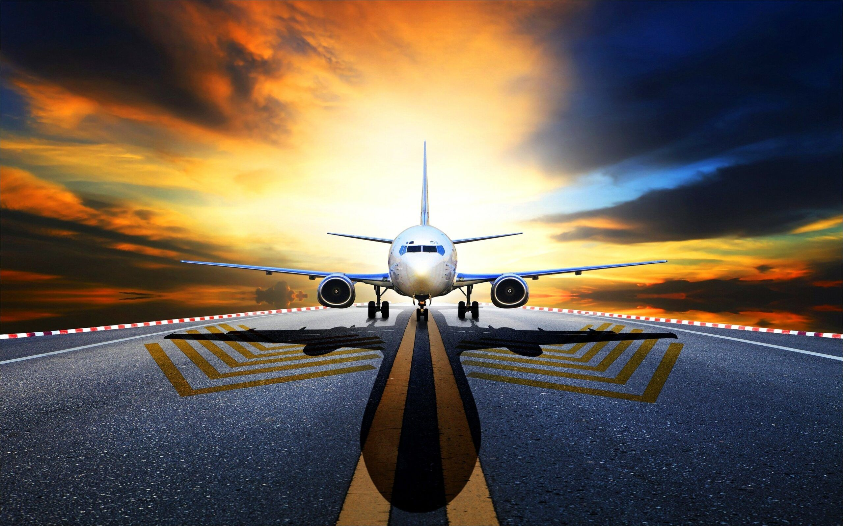
General Insights:
Economy Class has the highest dissatisfaction rate (35% rated it 1).
First Class has a more balanced rating distribution, indicating a fair mix of experiences.
Premium Economy and Business Class have notable dissatisfaction levels but are still better than Economy Class.
Business Class does not have as high a satisfaction rate as expected, which may indicate a need for improvements.

Slide 10
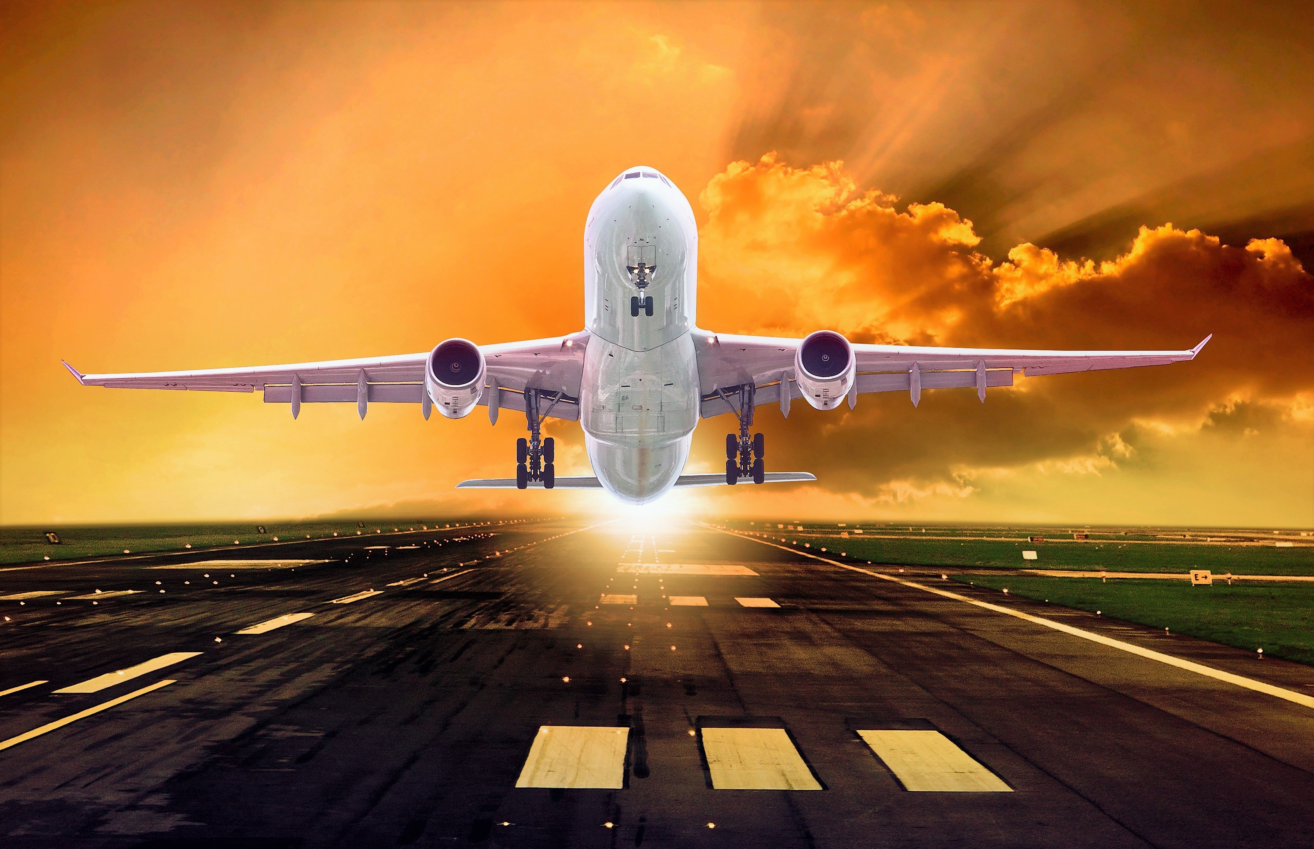
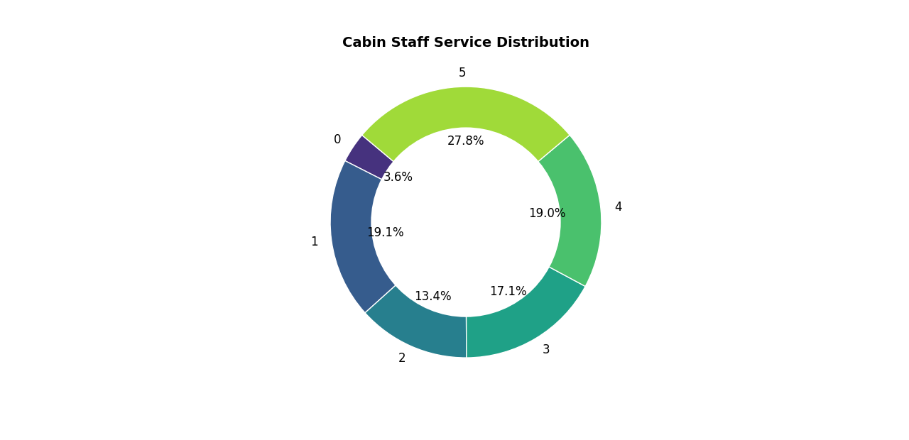

Cabin Staff Service by Seat Type

Slide 11
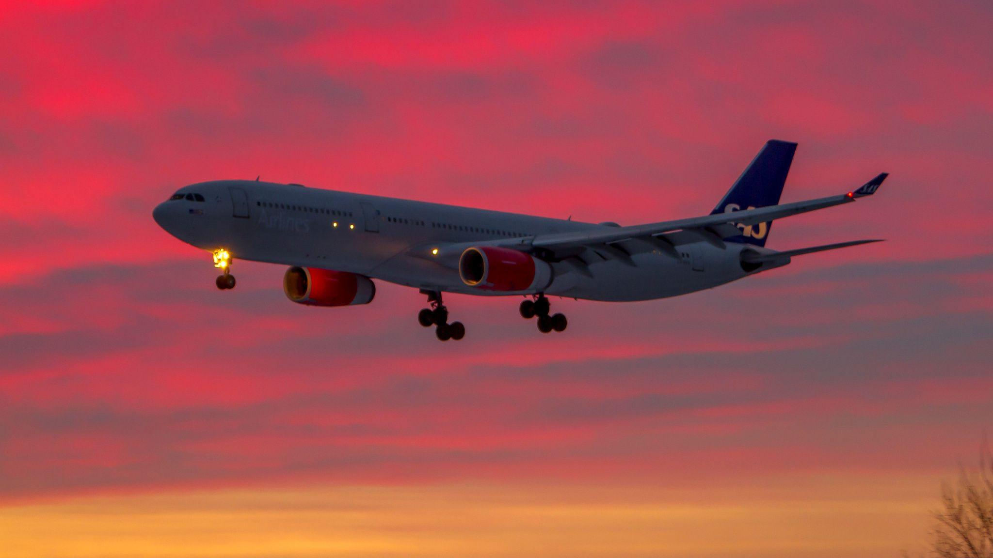
Analysis
Avg rating by staff service in Business Class - 3.4/5
Avg rating by staff service in Economy Class - 3.0/5
Avg rating by staff service in First Class - 3.9/5
Avg rating by staff service in Premium 3.1/5

Slide 12

General Insights:
✅ Good Performance:
The highest proportion (27.8%) of passengers gave the service 5 stars, suggesting overall positive feedback.
⚠ Areas of Improvement:
A combined 19.6% of passengers rated the service between 1 and 2, which could highlight inconsistencies in service quality.
Staff training on customer interaction and consistency could help address lower ratings.

Slide 13
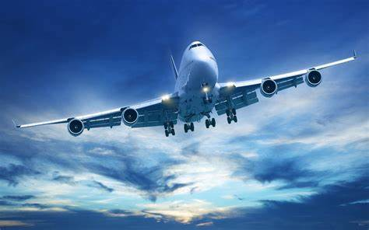
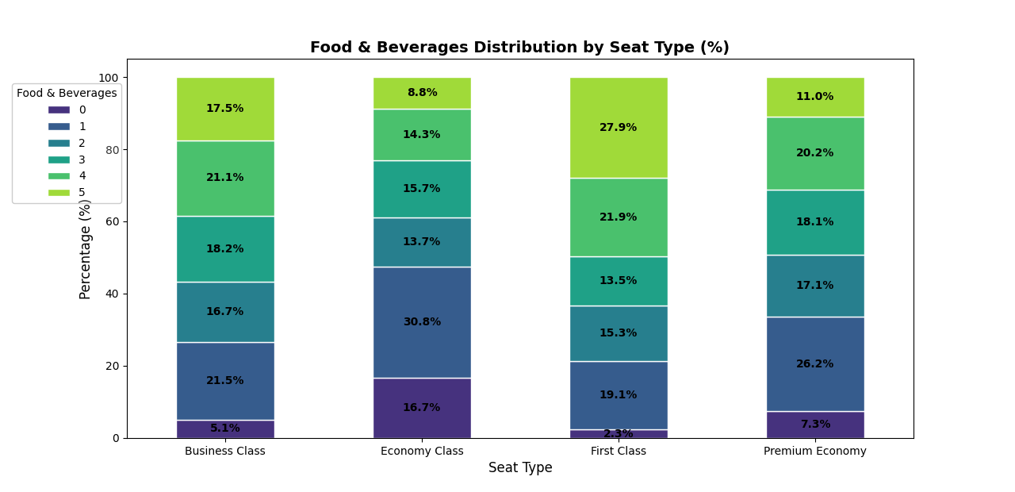
Food And Beverage Rating By Seat Type

Slide 14
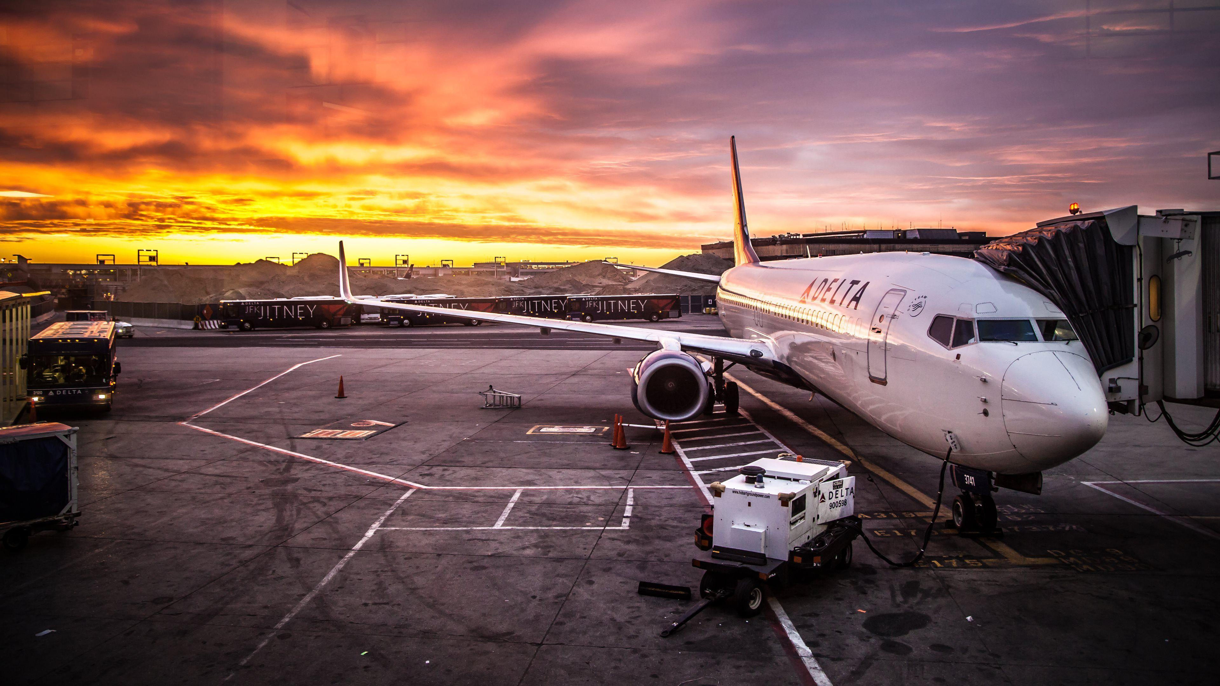
Analysis
Avg rating by food service in Business Class - 2.9/5
Avg rating by food service in Economy Class - 2.4/5
Avg rating by food service in First Class -3.2/5
Avg rating by food service in Premium Class - 2.7/5

Slide 15
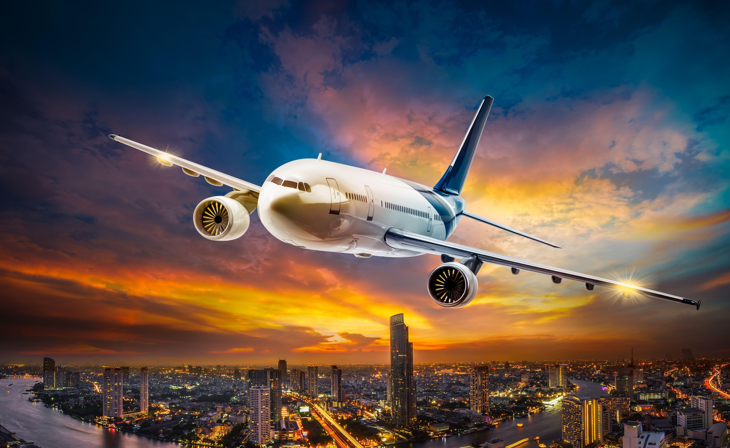
Improvement Areas for Airlines
✅ Enhance Economy Class food quality to reduce the high percentage of low ratings.
✅ Maintain or further improve First Class offerings to keep satisfaction levels high.
✅ Better differentiate Business Class and Premium Economy food services to justify pricing and customer expectations.

Slide 16

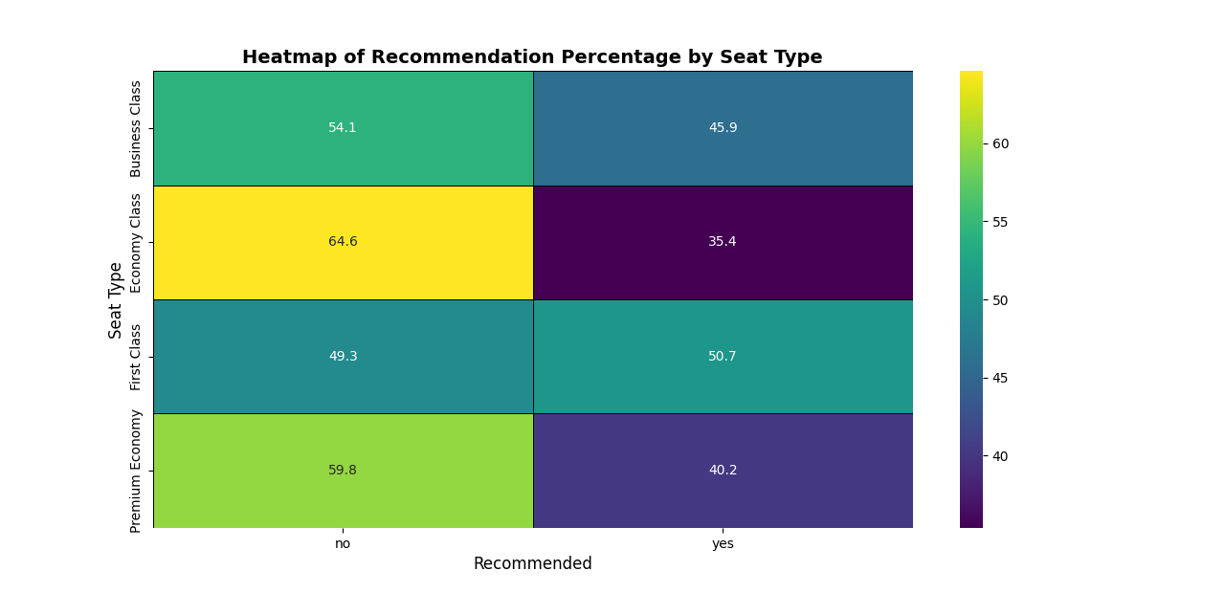
Recommendation Rating By Seat Type

Slide 17

Analysis
Economy Class has the lowest recommendation rate (35.4%)
First Class has the highest recommendation rate (50.7%)
Premium Economy (40.2% recommended) and Business Class (45.9% recommended) have moderate recommendation rates

Slide 18
Areas for Improvement
Economy Class Overhaul 🚀
Improve seat comfort, food quality, and entertainment to increase satisfaction and recommendation rates.
Enhance Business & Premium Economy Differentiation ✨
Highlight exclusive benefits to justify pricing and boost customer recommendations.
Optimize First-Class Experience 🏆
Focus on premium service refinements to increase recommendation rate further.

Slide 19
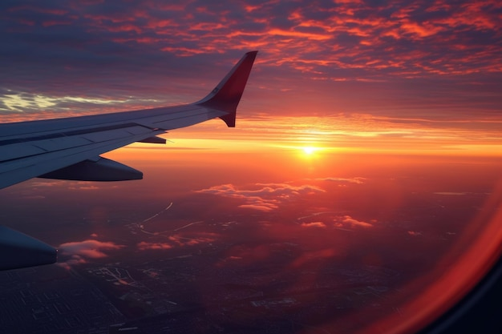
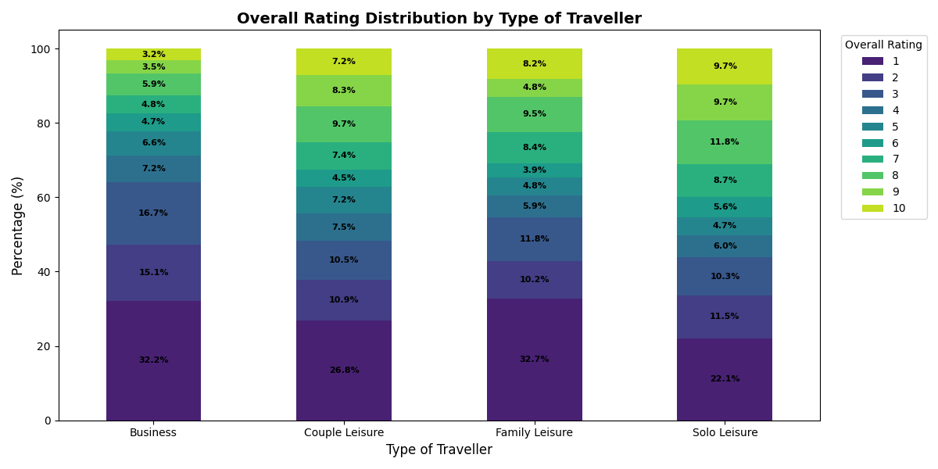
Avg Rating By Type Of Traveller

Slide 20

Analysis
Avg rating by type of traveller in Business Class - 3.4/10
Avg rating by type of traveller in Economy Class - 4.4/10
Avg rating by type of traveller in First Class - 4.1/10
Avg rating by type of traveller in Premium Class - 4.9/10

Slide 21

Insights & Recommendations:
✅ Strengths:
Solo Leisure travelers gave the highest positive ratings, suggesting good service quality for solo travelers.
Couple and Family Leisure travelers had a relatively even rating spread, meaning some areas are performing well, but improvements could be made.
⚠ Areas for Improvement:
Business travelers showed the highest dissatisfaction (32.2% rated 1) → Possible reasons: service expectations, business-class experience, or airport facilities. Enhancing premium services (e.g., faster check-ins, lounge access) may help.
Family Leisure travelers also had a high 1-star rating (32.7%) → Addressing concerns related to family-friendly amenities and seating could improve satisfaction.

Slide 22

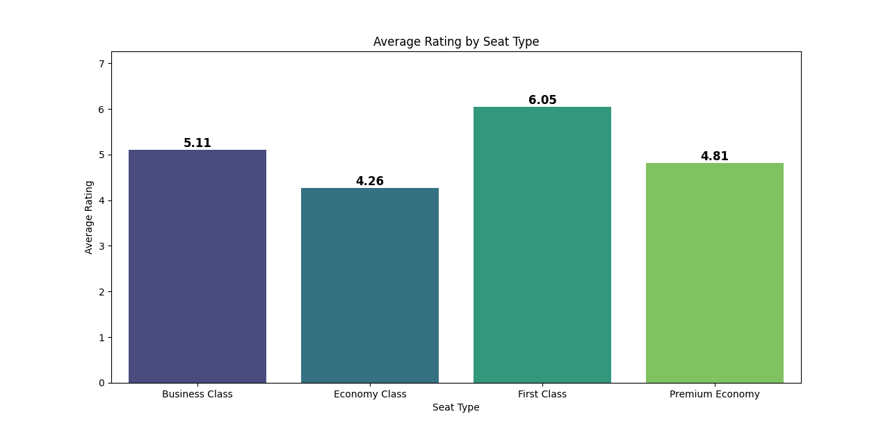
Avg Rating By Seat Type

Slide 23

Analysis
Over all rating by seat type for Business Class - 5.1/10
Over all rating by seat type for Economy Class - 4.2/10
Over all rating by seat type for First Class - 6.0/10
Over all rating by seat type for Premium Class - 4.8/10

Slide 24
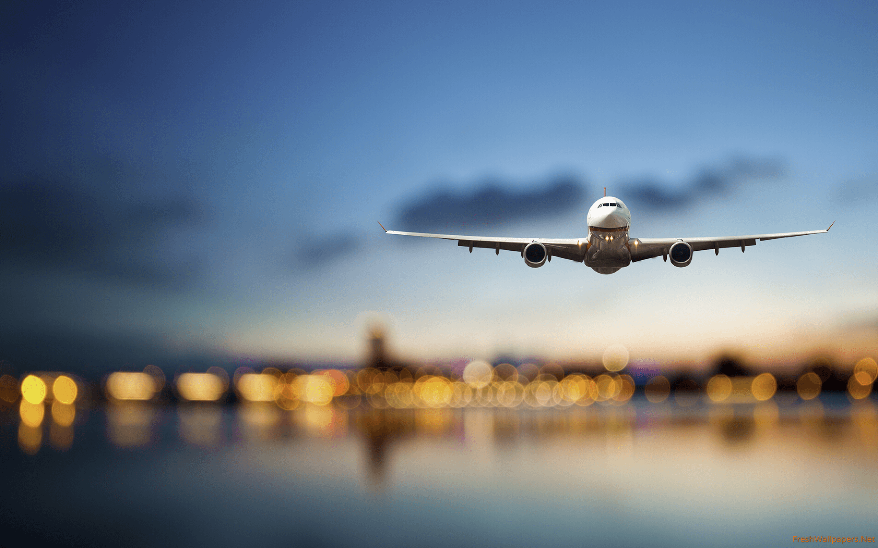
Considerations for Airlines
Upgrade Economy Class experience: Providing extra legroom, better food options, or improved entertainment could increase ratings.
Leverage First Class satisfaction: Airlines should market First Class more aggressively since it has the highest rating.
Understand Business vs. Premium Economy perceptions: Since their ratings are similar, airlines should differentiate them more clearly.

Slide 25
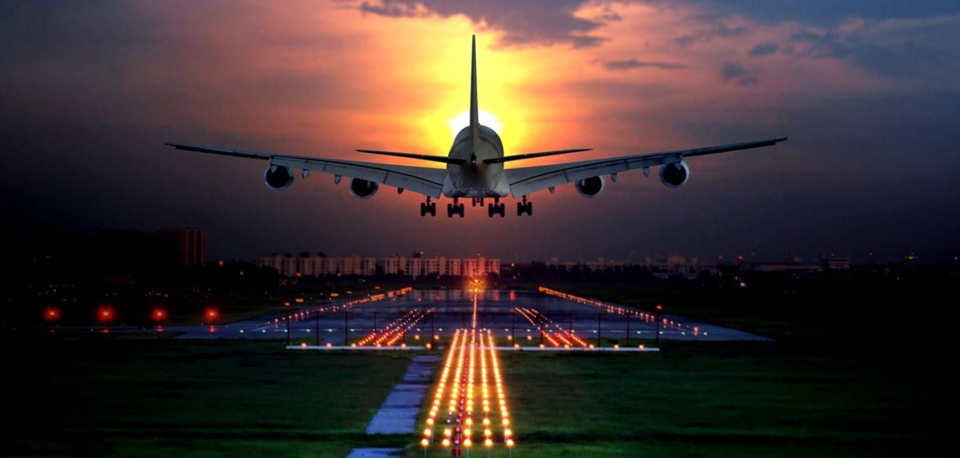
Analysis Review
Economy Class passengers are the most dissatisfied, possibly due to comfort, service, or value for money.
Even premium seat types (First Class, Business, and Premium Economy) have a noticeable dissatisfaction rate.
The airline may need to investigate issues in Economy Class to improve customer satisfaction.

Slide 26
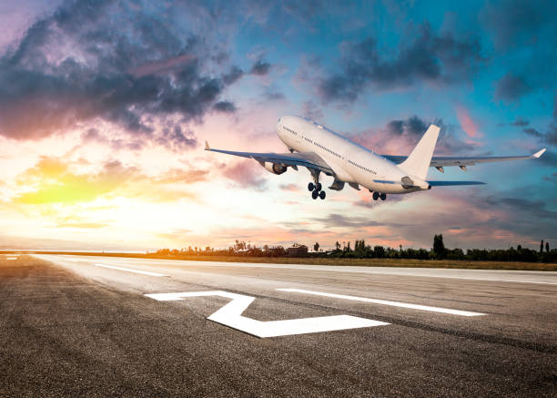
Review Summary
Average customer rating: 4.6/5
Service quality: High
Common praises: Comfortable seats, friendly staff
Common complaints: Delays, baggage issues
✅ Great experience in Business/First Class, with good seating, food, and customer service.
❌ Frustrating experience in Economy, with cramped seating, delays, poor baggage handling, and weak customer support.

Slide 27
Pros & Cons
✅ Comfortable seating
✅ Friendly staff
✅ Smooth check-in process
✅ Good in-flight entertainment
❌ Occasional delays
❌ Baggage handling issues
❌ Uncomfortable Economy Seats
❌ Limited meal options
❌ Poor Customer Service

Slide 28

Customer Feedback
"The staff was incredibly polite and attentive. They went out of their way to make sure we were comfortable. Best flight experience ever!"
"Waited over an hour at the customer service desk, only to be told they couldn’t do anything about my missed connection."

Slide 29

Conclusion
🛠 Areas for Improvement: Enhance baggage handling, improve punctuality, upgrade in-flight entertainment options
✅ Strengths: Excellent first-class experience, well-trained staff, and good food quality in premium classes
🔍 Key Focus Areas: Economy class comfort, premium service differentiation, consistency in Business Class service

Slide 30


